Slide 1

Predlozi
Tamara Pavlović BCS 2023

Slide 2
Šta su predolozi?
A preposition is a word or group of words used before a noun, pronoun, or noun phrase to show direction, time, place, location, spatial relationships, or to introduce an object. Some examples of prepositions are words like "in," "at," "on," "of," and "to."

Slide 3
Highlight the prepositions and write the meaning in conversation from Lesson 4
Svi đaci sede u klupama. ___________
Nastavnik stoji ispred đaka. _________
Iza nastavnika nalazi se na zidu velika školska ploča. _________
Nastavnik piše po tabli kredom. _____________
Pod klupom je đačka torba. ______________
Neki đaci je zapisuju bez greške. ___________

Slide 4
Highlight the prepositions and write the meaning in conversation from Lesson 4
Svi đaci sede u klupama. in
Nastavnik stoji ispred đaka. In front
Iza nastavnika nalazi se na zidu velika školska ploča. On/at
Nastavnik piše po tabli kredom. On
Pod klupom je đačka torba. Under
Neki đaci je zapisuju bez greške. Without

Slide 5
Padeži sa predlozima

Slide 6
Prepositions with genitive case
BEZ – without
Ex. Hoćemo čaj bez šećera.
__________________________
IZ- from (use this preposition to say that you are from a particular city/village/country)
A: Odakle si?
B: Ja sam iz Kruševca. Odakle ste vi?

Slide 7
Prepositions with genitive case
KOD- at, by- when it is not used with the verbs of motion. It always implies somebody’s place.
Ja sam kod babe i dede/djeda.
Ona čita i piše kod kuće.
Mi pijemo kafu/kavu i rakiju kod Mehmeda i Sanele.
OD – DO- from…to
Ja idem od Urbane do Čikaga.
Od Njujorka do Los Anđelesa se putuje četiri sata.
Od Bostona do Sarajeva je daleko.
Ja radim od sedam do tri.

Slide 8
Prepositions with genitive case
PORED, DO- next to
Ja sam do prozora, a ti si pored mene.
Pored Jovane sedi/sjedi Marija, a do Marije njihov drug.
ISPRED=in front of IZA=behind
Ispred kuće raste veliko drvo. Iza ovog automobila je jedna mala mačka.

Slide 9
Prepositions with genitive case
PRE (S)/PRIJE (BC) - before POSLE/POSLIJE – after
Pre časa (S)/Prije časa (B)/ Prije sata (C) idem u kafić.
Posle/Poslije tenisa idem u teretanu.

Slide 10
Answer the questions
Gde idete posle predavanja?
Ko je pored vas?
Odakle su vaši roditelji?

Slide 11
Accusative case with prepostions

Slide 12
NA and U come after the verbs of motion
NA
U
You need to remember that NA is used for: koncert, univerzitet/sveučilište, čas (S,B)/sat(C)
Idem na concert. I am going to the concert.
Vi idete na univerzitet/sveučilište. You are going to the university.
U is used for: škola, restoran, bolnica, park…
Ona ide u restoran. She is going to the restaurant.
Ja idem u školu. I am going to school.
Mama ide u ovaj park. My mother is going to this park.
Oni putuju u Evropu(S,B)/Europu (C). They are traveling to Europe.

Slide 13
U + days of the week in Accusative case ----to render English - on Monday, on Tuesday (u ponedeljak/ponedjeljak, u utorak). In fact only those days of the week of feminine gender will change their endings. We do not capitalize days of the week.
U nedelju/nedjelju idem u restoran, a u petak idem na koncert.
U sredu/srijedu moj brat ide u Evropu/Europu.
Ona hoće da gleda/gledati film u subotu.

Slide 14
Review. Make meaningful sentences by using correct froms of the following words. All verbs, nouns, adjectives are given in their basic forms!
Ja (kupovati) (bicikl) za (sestra).
Marko i Jasna (ići) u (grad) zajedno.
Mi (biti) za (ovo), a (ne biti) za (to).
Kroz (prozor) (gledati) nebo.
Oni često (čitati) (interesantna knjiga) u autobusu.

Slide 15
Review. Make meaningful sentences by using correct froms of the following words. All verbs, nouns, adjectives are given in their basic forms!
Ja kupujem bicikl za sestru.
Marko i Jasna idu u grad zajedno.
Mi smo za ovo, a ne za to.
Kroz prozor gledam u nebo.
Oni često čitaju interesantne knjige u autobusu.

Slide 16
Preposition combination with genitv and akuzativ

Slide 17
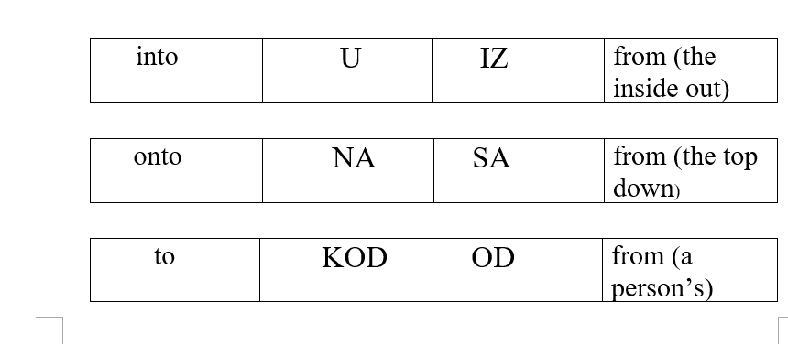
Prepositions that mean from: Iz, sad, od
Prepositional phrases corresponding to English “(to go) to a place” and “(to go) from the same place” are strictly paired.

Slide 18
Pair U/IZ
When you use U+ accusative case to go to a place (with verbs of motion), use IZ + genitive case to express the return (coming back from the place).
Primer. Mi idemo u restoran, a moja sestra ide iz restorana.
Can you come up with exaples?

Slide 19
Pair na/sa
When you use NA+acc to go to a place, use SA+gen for to go from the place.
Ex. Saša ide na utakmicu kada se vrati sa koncerta.
Idem na trening kad se vratim sa ______________________.
Idem na _______________ kad se vratim sa ručka.

Slide 20
Pair kod/od
When you use KOD+gen to go to a place, use OD+gen for returning from there. Used mostly with people.
Ex. Oni idu kod Marka, a ja idem od njega.
Oni idu kod doktora, a ja idem od __________.
Oni idu kod _____________, a ja idem od profesora.

Slide 21
Dative with prepositions
Prema/ka –toward
Idem prema tebi. I am heading toward you.
Ja vozim prema Njujorku. I am driving toward New York.
Avion/zrakoplov leti prema Beogradu. The plane is flying to (in the direction of) Belgrade.
After verbs of motion prema is frequently interchanged with k/ka:
Ja vozim ka Njujorku. Avion/zrakoplov leti ka Beogradu.

Slide 22
LOCATIVE ALWAYS GOES WITH PREPOSITIONS

Slide 23
Preposition O:
O “about, of” after verbs: govoriti, reći (to talk, say about), misliti (to think)
Ja govorim o vama, a ne o njima.
Marija misli o njemu.
Mi govorimo o američkoj istoriji/povijesti.
Mama misli o svojoj deci/djeci.

Slide 24
Po “on or along the surface of smth”
Ja šetam po parku. I walk around the park.
Idem po staroj ulici. I walk along an old street.
Putujem po Americi. I travel around America.
Po mom mišljenju /according to my opinion

Slide 25
U (in, at), NA (on, at)
U and Na are used with both Accusative and Locative cases, depending on whether motion or location is involved. If talking about where something or someone is located, use locative case. Locative case is usually followed by the verb biti (to be) to mean action, or presence in, or, at some place.

Slide 26
Locative na/u
Ja sam u velikoj banci. (verb to be, place)
Milena je u školi.
Mačka spava na terasi. (terasa-balcony)
Ja sam na univerzitetu/sveučilištu.
Oni žive u Splitu. (Split-a city in Croatia)
Ana je bila na Kubi. (Kuba-Cuba)
Deca/djeca se igraju u pesku/pijesku. (sand)

Slide 27
INSTRUMENTAL

Slide 28
S/Sa- with
Idem sa _______ (Marija) u školu.
Sa ______ (Petar) sam na pikniku.
Devojka sa _________ (crvena haljina) je tamo.

Slide 29
You already know the following prepositions that go with the genitive case:
IZA-ISPRED (behind, in front of) and IZNAD-ISPOD (above, under)
Ja sam iza tebe. Knjiga je ispod stola.
But if we make them short ZA, PRED, NAD, POD, then these prepositions require from what follows to be in the instrumental case. Yet, the meaning is exactly the same.
Ti si pred školom. Knjiga je pod stolom.
* keep in mind that we say “za stolom“- meaning “at the table“
Mi jedemo za stolom. Ja učim za stolom.

Slide 30
MOJA STAN
Find translation and answer the following questions:
Šta je pored lifta, a šta je ispod lifta?
Šta je pored spavaće sobe?
Šta je ispred kuhinje?
Šta je na zidu?

Slide 31
homework
Thursday- Textbook, Lesson 4, Vježba 3 i 4- page 23
Flip- Friday, video
Describe a room/apartment/space using prepositions and cases we practiced. Include:
Flip- Friday, video
Use at least 5 prepositions.
Use at lest once a noun/adj. in genitive
Use at lest once a noun/adj. in accusative
Use at lest twice a noun/adj. in dative
Use at lest twice a noun/adj. in locative
Use at lest twice a noun/adj. In instrumental
Saturday, questions. Sunday, answers.
Monday, movie reccomendations.
Start preparing for Wrap up test on Tuesday.

